Slide 1
Introduction to Programming with RAPTOR

Slide 2
Objectives
Use of the terminal symbol
Use of the flow line
Use of the input/output symbol
Use of the process symbol
Use of the decision symbol

Slide 3
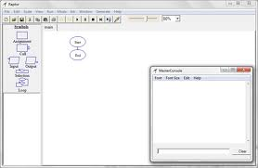
What is RAPTOR?
RAPTOR : Is a visual programming development environment based on flowcharts.

Slide 4
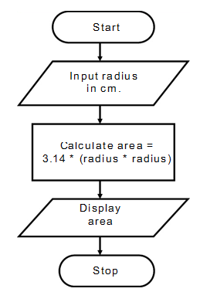
A flowchart
A flowchart Is a collection of connected graphic symbols, where each symbol represents a specific type of instruction to be executed.
The connections between symbols determine the order in which instructions are executed.

Slide 5

RAPTOR Program Structure
A RAPTOR program : Is a set of connected symbols that represent actions to be performed.
The arrows that connect the symbols, determine the order in which the actions are performed.

Slide 6
Executing a RAPTOR program
When executing a RAPTOR program, you begin at the Start symbol and follow the arrows to execute the program.
A RAPTOR program stops executing when the End symbol is reached.
Start
End

Slide 7
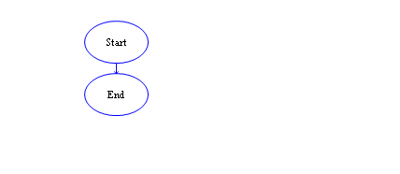
The smallest RAPTOR program
By placing additional RAPTOR statements between the Start and End symbols you can create meaningful RAPTOR programs.

Slide 8
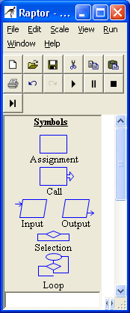
Introduction to RAPTOR Statements/Symbols
RAPTOR has six (6) basic symbols.
Each symbol represents a unique type of instruction.

Slide 9
Computer Program Components
The typical computer program has three basic components:
INPUT – get the data values that are needed to accomplish the task.
PROCESSING – manipulate the data values to accomplish the task.
OUTPUT – display (or save) the values which provide a solution to the task.

Slide 10
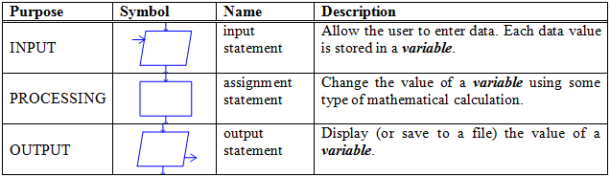
These three components have a direct correlation to RAPTOR instructions as shown in the following table.

Slide 11
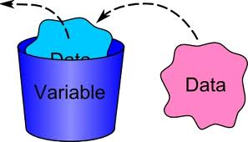
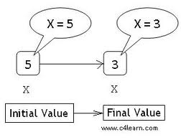
RAPTOR Variables
Variables : Are computer memory locations that hold a data value.
At any given time a variable can only hold a single value.
The value of a variable can vary (change) as a program executes. That's why we call them "variables"!

Slide 12
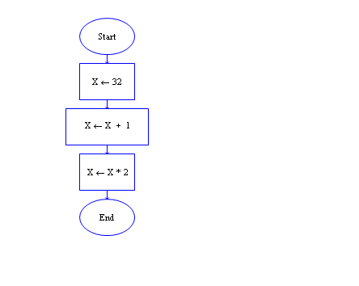
Example 1

Slide 13
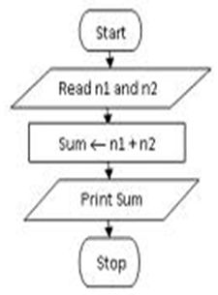
Example 2

Slide 14
How to change the value of variable?
A variable can have its value set (or changed) in one of three ways:
By the value entered from an input statement.
By the value calculated from an equation in an assignment statement.
By a return value from a procedure call (more on this later).

Slide 15
Variable Name
Meaningful and descriptive.
Should relate to the purpose the variable serves in the program.
Must start with a letter.
Can contain only letters, numerical digits, and underscores (but no spaces or other special characters).
If a variable name contains multiple "words," the name is more "readable" if each word is separated by an underscore character.

Slide 16
The table below shows some examples
of good, poor, and illegal variable names:
Good variable names | Poor variable names | Illegal variable names
tax_rate sales_tax distance_in_miles mpg | a (not descriptive) milesperhour (add underscores) my4to (not descriptive) | 4sale (does not start with a letter) sales tax (includes a space) sales$ (includes invalid character)

Slide 17
Variable's Data Type
A variable's data type cannot change during the execution of a program.
In summary, variables are automatically created by RAPTOR and can hold either:
Numbers e.g., 12, 567, -4, 3.1415, 0.000371, or
Strings e.g., “Hello, how are you?”, “James Bond”, “The value of x is ”

Slide 18
Common errors when using variables:
Error 1: "Variable ____ does not have a value“.
There are two common reasons for this error:
The variable has not been given a value.
The variable name was misspelled.

Slide 19
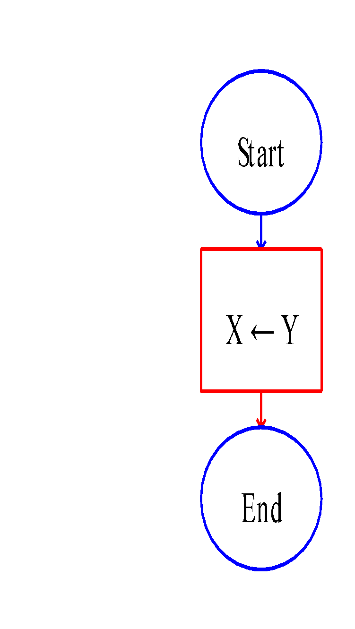
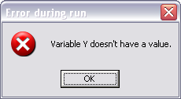
The variable has not been given a value

Slide 20
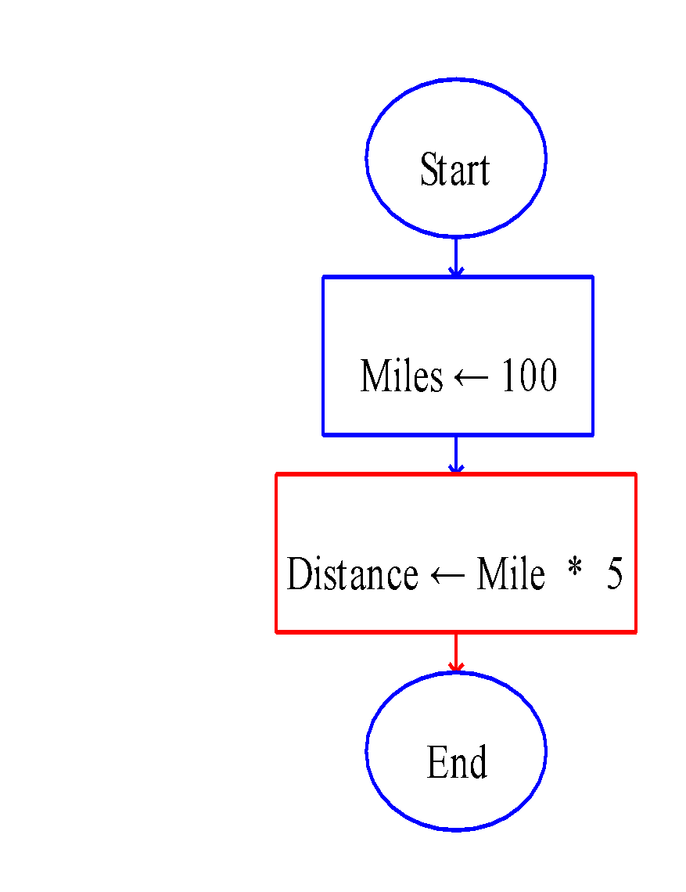
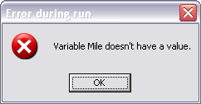
The variable name was misspelled

Slide 21
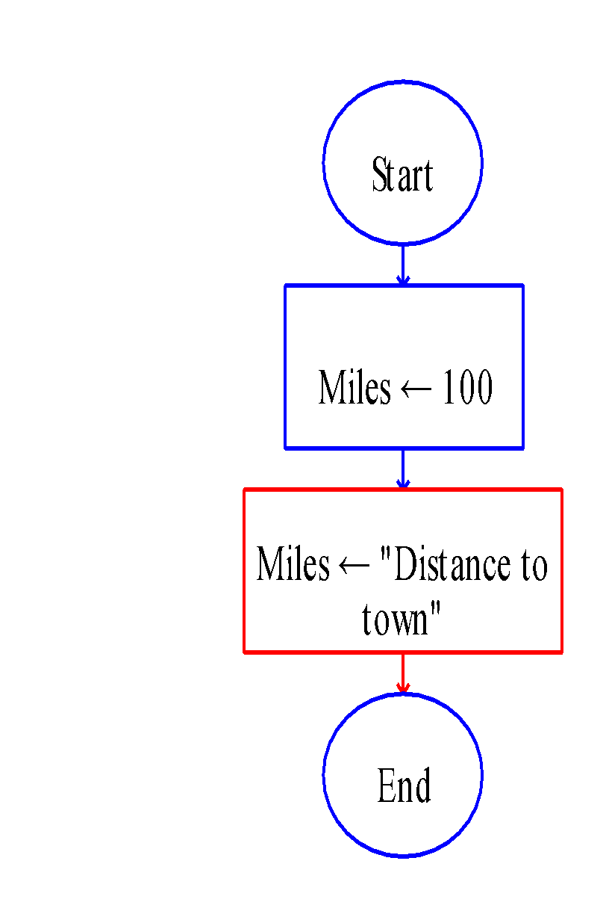
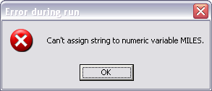
Error 2:
"Can't assign string to numeric variable _____"
"Can't assign numeric to string variable _____"
This error will occur if your statements attempt to change the data type of a variable

Slide 22
RAPTOR Statements/Symbols
Four basic statements:
Input Statement.
Assignment Statement.
Call Statement.
Output Statement.

Slide 23
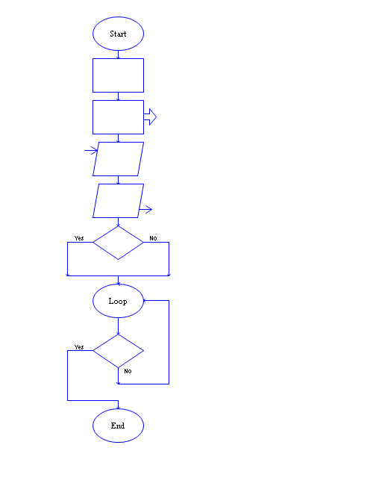
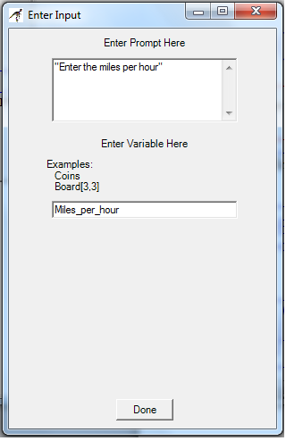
Input Statement/Symbol
An input statement/symbol allows the user of a program to enter a data value into a program variable during program execution.
When you define an input statement, you must specify two things:
a prompt .
The variable that will be assigned the value enter by the user at run-time.

Slide 24
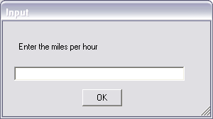
Input Statement/Symbol
At run-time, an input statement will display an input dialog box.
After a user enters a value and hits the enter key (or clicks OK), the value entered by the user is assigned to the input statement's variable.

Slide 25
Prompt
Is a string of text that describes the required input.
If the expected value needs to be in particular units (e.g., feet, meters, or miles) you should mention the units in the prompt.
An Expression prompt enables you to mix text and variables together like the following prompt: “Enter a number between ” + low + “ and ” + high + “: ”.

Slide 26
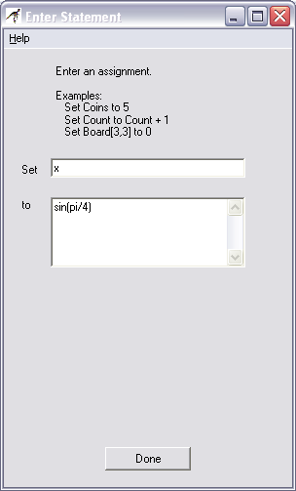
Assignment Statement/Symbol
The assignment symbol is used to perform a computation and then store the results in a variable.

Slide 27

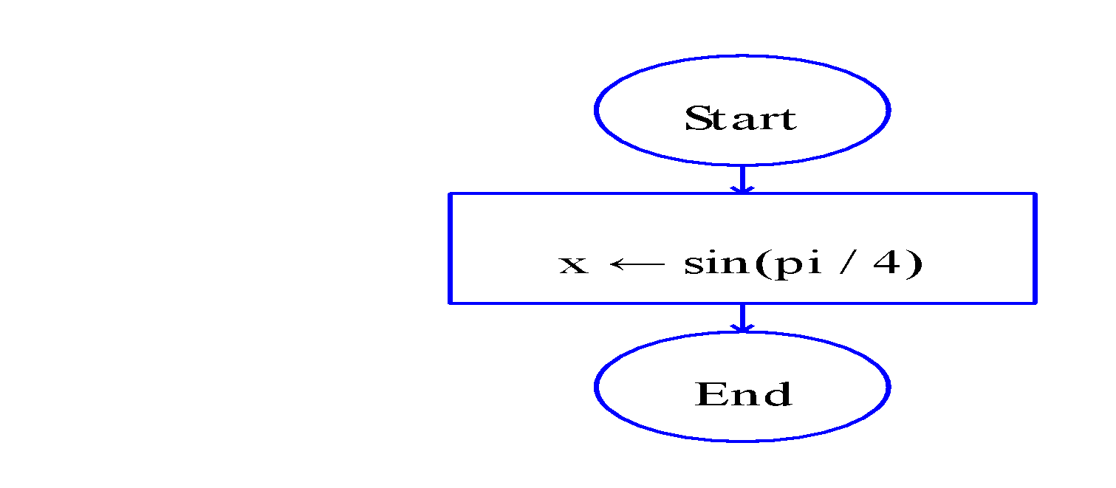
Assignment Statement/Symbol
An assignment statement is displayed inside its RAPTOR symbol using the syntax:

Slide 28
Assignment Statement/Symbol
One assignment statement can only change the value of a single variable.
If this variable did not exist prior to the statement a new variable is created.
If this variable did exist prior to the statement.
No variables on the right hand side of the arrow (i.e., the expression) are ever changed by the assignment statement.

Slide 29
Expressions
The expression (or computation) of an assignment statement can be any simple or complex equation that computes a single value.
An expression is a combination of values (either constants or variables) and operators.
A computer can only perform one operation at a time.

Slide 30
Execution of the operations
The operations are performed based on a predefined "order of precedence."
For example, consider the following two examples:
x ← (3+9)/3 x ← 3+(9/3)

Slide 31
Operator & function
An operator or function directs the computer to perform some computation on data.
Operators are placed between the data being operated on (e.g. X/3).
functions use parentheses to indicate the data they are operating on (e.g. sqrt(4.7) ).

Slide 32
Built-in operators and functions of RAPTOR
Basic math: +, -, *, /, ^, **, rem, mod, sqrt, log, abs, ceiling, floor
Trigonometry: sin, cos, tan, cot, arcsin, arcos, arctan, arccot
Miscellaneous:random, Length_of

Slide 33
Assignment Statement/Symbol
The result of evaluating an expression in an assignment statement:
A single number.
A single string of text.

Slide 34
Output Statement/Symbol
An output statement displays a value to the MasterConsole window when it is executed.
When you define an output statement, the "Enter Output" dialog box appear.

Slide 35
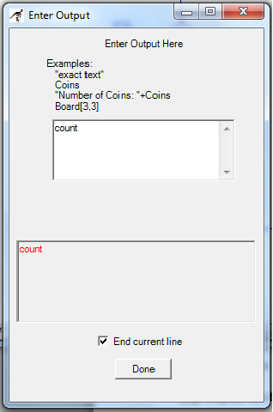
Output Statement/Symbol
When you define an output statement, the "Enter Output" dialog box appear.
If you include quote marks (") in the text, the quote marks will be displayed exactly as you typed them.
Notes:
If you include quote marks (") in the text, the quote marks will be displayed exactly as you typed them.

Slide 36
Output Statement/Symbol
You can display multiple values with a single output statement by using building a string of text using the string plus (+) operator.
When you build a single string from two or more values, you must distinguish the text from the values to be calculated by enclosing any text in quote marks (").

Slide 37
Output Statement/Symbol
the quote marks are not displayed in the output window. For example, the expression,
"Active Point = (" + x + "," + y + ")"
will display the following if x is 200 and y is 5:
Active Point = (200,5)

Slide 38
Display the results in a user-friendly manner
This means you should display some explanatory text explaining any numbers that are output to the MasterConsole window.

Slide 39
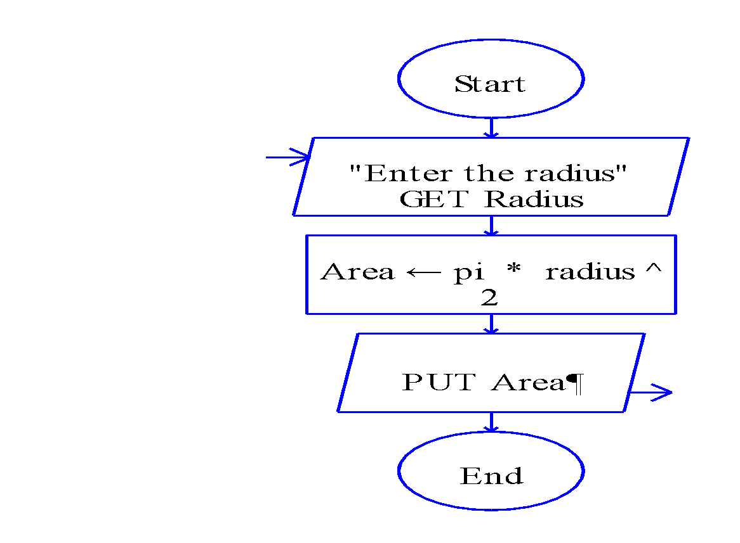
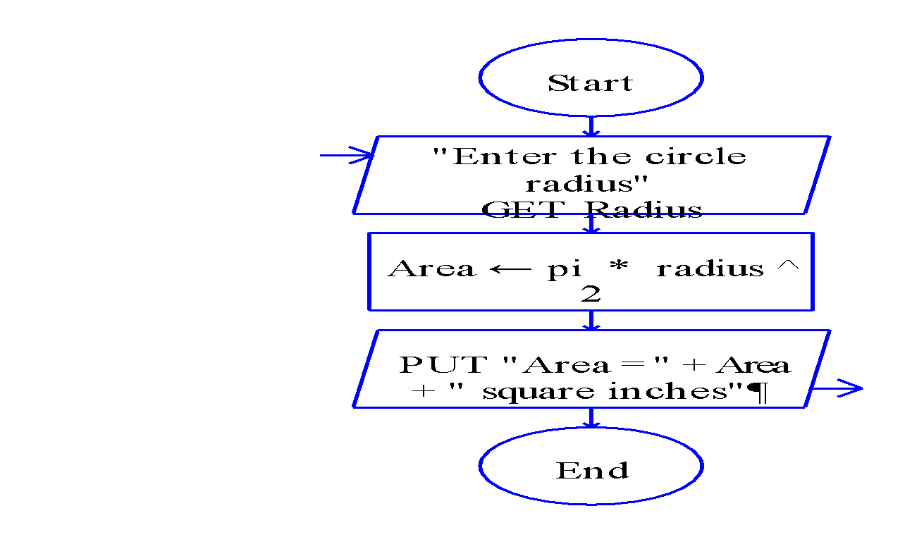
Example
Non-user-friendly output | User-friendly output
Example output: 2.5678 | Example output: Area = 2.5678 square inches

Slide 40
Comments in RAPTOR
Comments are used to explain some aspect of a program to a human reader, especially in places where the program code is complex and hard to understand.
Comments mean nothing to the computer and are not executed

Slide 41
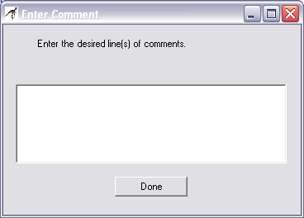
To add a comment to a statement
Right-click your mouse over the statement symbol.
Select the "Comment" line before releasing the mouse button.
Enter the comment text into the "Enter Comment" dialog box.

Slide 42
Types of comments
There are three general types of comments:
Programmer header – documents who wrote the program, when it was written, and a general description of what the program does. (Add to the "Start" symbol)
Section description – mark major sections of your program to make it easier for a programmer to understand the overall program structure.
Logic description – explain non-standard logic.

Slide 43
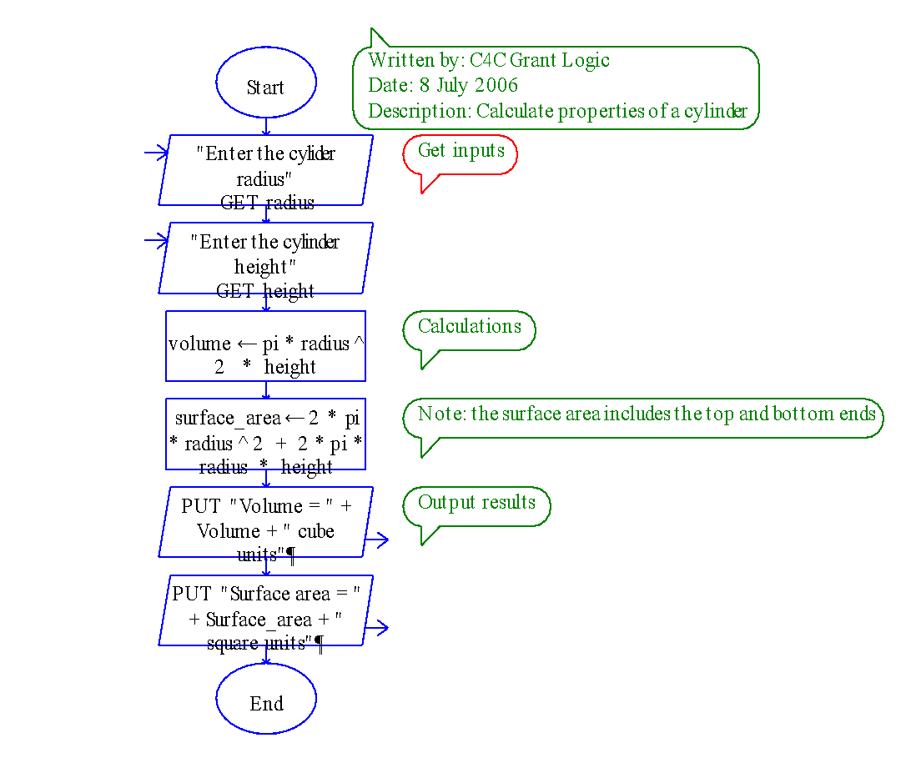
Comments in RAPTOR
Typically you should not comment every statement in a program.

Slide 44
Any Questions
?

Slide 45
Thank you

